Slide 1
Machine Learning, Big Data, Algorithms & Intelligent Systems
CS 435 Algorithms – Advanced Topics
Emdad Khan

Slide 2
CS 582
Emdad Khan
ekhan@mum.edu
Dept. of Computer Science
Maharishi University of Management
Nov. , 2016
Machine Learning: Getting Computers
to Program Themselves
“Discovering the Learning Dynamics of the Laws of Nature”

Slide 3
Overview: Machine Learning (CS 582)
A Core Course for Data Science and Big Data
Connects Parts to the Wholeness of the Data Science / Big Data Program: Big Data, Data Analytics, Natural Language Processing; ALSO connected to Algorithms, FPP, MPP, SWE, WAP, WAA,…..
Direct use of Learning from SCI
Strong Connection to the Industry: Design, Implement, Test, Manage S/W,…
Essential for Growth: Solving Future Problems
Helping the Society and Leading to Prosperity
Knowledge, Action, Achievement and Fulfillment

Slide 4
What is Machine Learning
Gives computers ability to learn from data & program themselves.
Programs can grow, reconfigure & change when exposed to new data.
Traditional Programming
Program
Output
Data
Computer
Machine Learning
Data
Program
Output
(desired)
Computer

Slide 5
Why Machine Learning?
Computers & Internet have significantly changed our lives & society.
Programming is the KEY for this.
Hence Improving & automating “How to program” is VERY important.
ML addresses this VERY important part.
We do NOT have good algorithms to solve Data Driven problems, for example, Regression and Classification:
Spam filtering
Detecting fraud transactions
Reliable Speech Recognition
Auto-driving of vehicles, …..
ML can successfully address all these problems.
ML is also the key for Big Data as the data size and complexity is very large; automation is a MUST for this.

Slide 6
Applications - 1
Many application areas - Software Engineering, Internet, Healthcare, Financing, Engineering, Automotive Industry, Physics, Biology, Bioinformatics, Meteorology, Economics, Education,……
Macy's Inc. and real-time pricing. The retailer adjusts pricing in near-real time for 73 million (!) items, based on demand and inventory, using technology from SAS Institute.

Slide 7
Applications - 2
Self driving Cars
Many sensors and many data.
Traditional Algorithm does / can NOT solve the problem.
ML approach Appropriately process the real-time data from sensors and make decisions as appropriate.
Google Self Driving Car -

Slide 8
Course Schedule
First offering in March (Feb 28), 2017.
Other offerings will be announced soon.
Prerequisite: CS 435 (algorithms) or consent of the instructor.
4 Units.
Group Project.

Slide 9
What Is Big Data?
The amount of data has been exploding FAST!
2 Exa Bytes (10 ^18) per day!
This Large data set is called Big Data
providing both challenges and opportunities
Notes:
Suggest go back to Internet centric. You do not have enough in this presentation to position the company as a gadget interface
Pls use another slide master. The current background is very distracting.

Slide 10
Big Data Applications
High Level:
Processing, Viewing, Analyzing,..
Extracting Meaning
Summarization
Document Analysis, Drawing Inference
Common Areas:
Business Analytics, Meteorology, Economics, Biology, Bioinformatics, Astronomy, Medicine,….)
Popular Areas:
Intelligent Information Retrieval, Search, Q & A, Language Translation
Notes:
Suggest go back to Internet centric. You do not have enough in this presentation to position the company as a gadget interface
Pls use another slide master. The current background is very distracting.

Slide 11
Key Problems With Big Data
Searching, Transferring, Sharing
Analyzing, Processing, Viewing
Deriving Meaning / Semantics
Summarization
Discovering Knowledge
Drawing Inference, Making Predictions
More (including mining)
Notes:
Suggest go back to Internet centric. You do not have enough in this presentation to position the company as a gadget interface
Pls use another slide master. The current background is very distracting.

Slide 12
Key Problems With Big Data
Notes:
Suggest go back to Internet centric. You do not have enough in this presentation to position the company as a gadget interface
Pls use another slide master. The current background is very distracting.

Slide 13
Key Problems are Related to:
5 Vs, namely the following:
Volume
Velocity
Variety
Variability (Veracity) [Typos., abbreviation, reliability, accuracy..]
Value [Need to convert the data into benefits / cost..]
A few other issues are semantics, security, privacy and usability.
Notes:
Suggest go back to Internet centric. You do not have enough in this presentation to position the company as a gadget interface
Pls use another slide master. The current background is very distracting.

Slide 14
Big Data Types
Unstructured
Texts on the Internet or other sources
Video
Images
Sound
Structured
Data in a Database
Unstructured Data Dominates with Wide Margin!
Notes:
Suggest go back to Internet centric. You do not have enough in this presentation to position the company as a gadget interface
Pls use another slide master. The current background is very distracting.

Slide 15
Issues Dealing with Unstructured Data
Semantic Meaning is needed
Context is very important
“John rides in a mustang” and “John rides on a
mustang”: (a) [2nd is riding on a horse] (b) O vrs. I might be a typo
World Knowledge is needed
Notes:
Suggest go back to Internet centric. You do not have enough in this presentation to position the company as a gadget interface
Pls use another slide master. The current background is very distracting.

Slide 16
Issues Dealing with Unstructured Data
Human brain can understand these instantly but computers cannot.
Keyword is not the answer.
Semantics using Predicate logic, Ontology and the like have issues – need to define semantics for almost everything!
Notes:
Suggest go back to Internet centric. You do not have enough in this presentation to position the company as a gadget interface
Pls use another slide master. The current background is very distracting.

Slide 17
Big Data – Key Ingredients
1. Infrastructure / frameworks / tools
[Map Reduce / Hadoop, Hive, Pig, Spark, Storm…]
2. Big Data Algorithms
3. Analytics (including emphasis on combining unstructured and structured data)
4. DB & Data Types (especially unstructured data and associated database e.g. NoSQL)
5. Natural Language Processing, AI, ML, UI
Notes:
Suggest go back to Internet centric. You do not have enough in this presentation to position the company as a gadget interface
Pls use another slide master. The current background is very distracting.

Slide 18
Some Current Applications - 1
Macy's Inc. and real-time pricing. The retailer adjusts pricing in near-real time for 73 million (!) items, based on demand and inventory, using technology from SAS Institute.

Slide 19
Current Applications -2
Wal-Mart Stores Inc. and search. The mega-retailer's latest search engine for Walmart.com includes semantic data. Polaris, a platform that was designed in-house, relies on text analysis, machine learning and even synonym mining to produce relevant search results. Wal-Mart says adding semantic search has improved online shoppers completing a purchase by 10% to 15%. "In Wal-Mart terms, that is billions of dollars," Laney said.

Slide 20
Current Applications - 3
Infinity Property & Casualty Corp. and dark data. Laney defines dark data as underutilized information assets that have been collected for single purpose and then archived. But given the right circumstances, that data can be mined for other reasons. Infinity, for example, realized it had years of adjusters' reports that could be analyzed and correlated to instances of fraud. It built an algorithm out of that project and used the data to reap $12 million in subrogation recoveries.

Slide 21
Applications - 4
PredPol Inc. and repurposing. The Los Angeles and Santa Cruz police departments, a team of educators and a company called PredPol have taken an algorithm used to predict earthquakes, tweaked it and started feeding it crime data. The software can predict where crimes are likely to occur down to 500 square feet. In LA, there's been a 33% reduction in burglaries and 21% reduction in violent crimes in areas where the software is being used.

Slide 22
Some Future Applications – Intelligent Internet, Intelligent Search, Question Answering, Summarization,…

Slide 23
The Progression of the Internet
Internet Sort of Started with Portal (like Yahoo)
Then Moved to Search (e.g. Yahoo, MSN, Google)
Then Moved to Transaction (eBay, Amazon)
Then to Social Networks (Facebook, Twitter)
What’s Next?
Notes:
Suggest go back to Internet centric. You do not have enough in this presentation to position the company as a gadget interface
Pls use another slide master. The current background is very distracting.

Slide 24
What’s Next?
We See a Clear Trend that the future Internet is going to be something that can provide
Very Specific
More Precise and Direct Information
In a Very Easy Way so that
Anyone including an Illiterate Person can Access and Use it at Ease
Notes:
Suggest go back to Internet centric. You do not have enough in this presentation to position the company as a gadget interface
Pls use another slide master. The current background is very distracting.

Slide 25
What’s Next?
This Means
Much Smaller set of Search Results Instead of Millions of Hits (Usually Under 100)
Answer (a Small set of Answers) to a Question
Summarization of Articles
Drawing Inference from set of Documents
More Including Specific Request, Smart Transactions
Using Natural Language Dialogues
Notes:
Suggest go back to Internet centric. You do not have enough in this presentation to position the company as a gadget interface
Pls use another slide master. The current background is very distracting.

Slide 26
The Next Generation Internet: Intelligent Internet (IINT)
Major Components
Big Data Handling Capability
Natural Language Capability
Intelligent Agent
Notes:
Suggest go back to Internet centric. You do not have enough in this presentation to position the company as a gadget interface
Pls use another slide master. The current background is very distracting.

Slide 27
Intelligent Internet (IINT): Architecture
Internet
W2
W3
Main Agent
(IA)
Sub Agent 1
Sub Agent 2
Agents of a Website, W1
Figure 1: Intelligent Internet (IINT) - showing a website with a main Intelligent Agent (IA) and 2 sub Agents. Sub Agents can perform functions like transactions or e-Learning etc. Such a website can have a Super Intelligent Agent (SIA) to handle more difficult tasks by collaborating with other websites. The Agents may reside on a different website(s).
Notes:
Suggest go back to Internet centric. You do not have enough in this presentation to position the company as a gadget interface
Pls use another slide master. The current background is very distracting.

Slide 28
Intelligent Internet (IINT): Key Algorithms
High Level Description as Each Can be a Separate Presentation
Delivering Requested Content
Calculating Some Functions – e.g. currency conversion
Performing Transactions – e.g. an e-Commerce application
Performing Teaching and Learning – e.g. an e-Learning application
Notes:
Suggest go back to Internet centric. You do not have enough in this presentation to position the company as a gadget interface
Pls use another slide master. The current background is very distracting.

Slide 29
Intelligent Internet (IINT): Key Algorithms
Performing Networking Type Activities
Intelligent Information Retrieval
Intelligent Search (Covered in the Demo)
General Q&A (Covered under Sample Application)
Summarization
Drawing Inference
Complex Content Manipulation
Notes:
Suggest go back to Internet centric. You do not have enough in this presentation to position the company as a gadget interface
Pls use another slide master. The current background is very distracting.

Slide 30
Some Applications - Search
Today’s Search
Uses String Match (# of words, IDF,….) Plus Page Ranking – Millions of hits!
Example - "Auto body shops in San Francisco bay area", Google gave the following:
" About 1,200,000 results (0,45 seconds) ".
There are probably not 1.2M Auto body shops in the whole world! So, there are Key Issues!
Notes:
Suggest go back to Internet centric. You do not have enough in this presentation to position the company as a gadget interface
Pls use another slide master. The current background is very distracting.

Slide 31
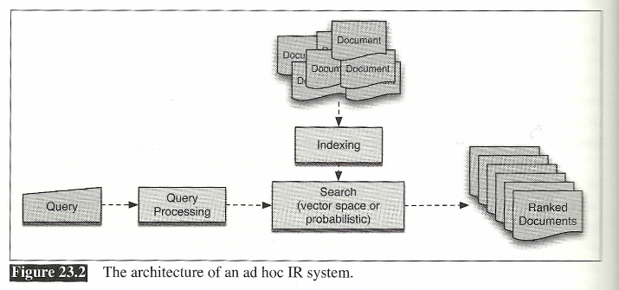
Applications: IR (Search) using Vector Space

Slide 32
Applications: IR (Search) Enhanced by Page Ranking
Number of links incoming to a page implies the importance of the page.
If a result comes from a very popular page (e.g. ABC News), then that result usually has much higher rank and so on.
Greatly Improved the quality of search results.
BUT – still produces thousands to millions of results? Why? (No semantics!...)
Example – next page

Slide 33
Applications: IR (Search) Enhanced by Page Ranking

Slide 34
DEMO on Intelligent Search
Intelligent Search Means Search That:
Uses Semantics and Deep Semantics (not just string matching) of NLP
Uses Meaning of Words to derive the Meaning of the (a) Input String / Sentence and (b) Title of the Results
Uses Semantic Matching of the Titles with Input Sentence to Derive Results
Demo Using SEBLA (Semantic Engine Using Brain-Like Approach) “Low Price Thai Restaurant Silicon Valley”
Notes:
Suggest go back to Internet centric. You do not have enough in this presentation to position the company as a gadget interface
Pls use another slide master. The current background is very distracting.

Slide 35
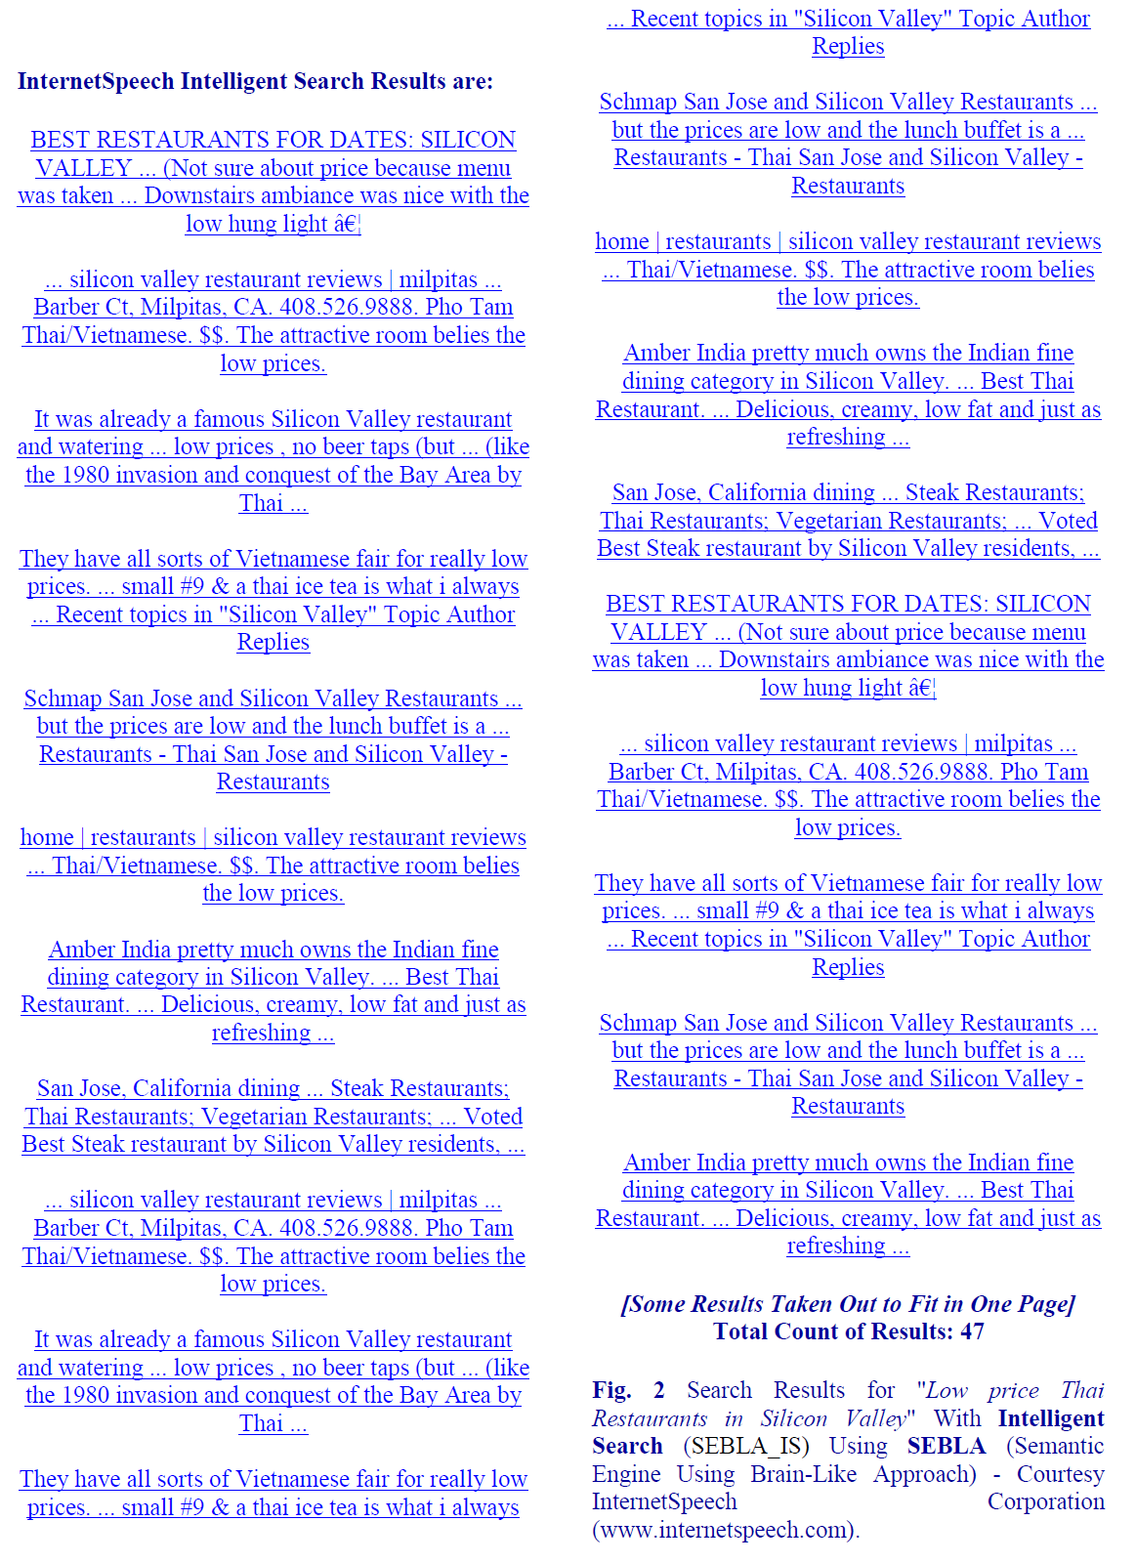
DEMO on Intelligent Search – Results (with Semantics)
Notes:
Suggest go back to Internet centric. You do not have enough in this presentation to position the company as a gadget interface
Pls use another slide master. The current background is very distracting.

Slide 36
How ML Relates to Your Future?
You will be working on Software and Programming.
Many data driven applications need ML today.
With the rapid growth of Big Data / Data Science, applications needing ML is growing very rapidly!
Thus, ML will help you in the following ways:
Higher chance to get jobs more quickly
Higher salary
Broader range of industries and companies
Rapid Future growth, especially when you also take S/W Engg., WAP, WAA, EA,..
Enable yourself to become an entrepreneur & innovator
ML, Big Data, AI & Natural Language Processing are hot areas
“A breakthrough in machine learning would be worth ten Microsofts” (Bill Gates, Microsoft)

Slide 37
References / Further Reading
[1] E. Khan, “Natural Language Processing: Key for Next Generation Big Data and Data Science” Plenary talk at 15th International Conference on Applied Computer and Applied Computational Science, March 18-20, 2016 http://www.wseas.org/wseas/cms.action?id=12693
[2] E. Khan, "Next generation web - intelligent search, question answering, summarization and more", INTERNATIONAL JOURNAL of COMPUTERS AND COMMUNICATIONS, (NAUN & UNIVERSITY PRESS), Vol. 9, June 2015.
[3] E. Khan, " Intelligent Internet: Natural Language and Question & Answer based Interaction”, INTERNATIONAL JOURNAL of COMPUTERS AND
COMMUNICATIONS, (NAUN & UNIVERSITY PRESS) Oct. 2013.
[4] E. Khan, "Natural Language Processing, Big Data, Bioinformatics and Biology”, INTERNATIONAL JOURNAL OF BIOLOGY AND BIOMEDICAL ENGINEERING (NAUN & UNIVERSITY PRESS), June 2014.
[5] C. Eaton et al, “Understanding Big Data: Analytics for enterprise class Hadoop and Streaming Data”, http://public.dhe.ibm.com/common/ssi/ecm/en/iml14296usen/IML14296USEN.PDF
[6] P. Ryan et al, “The Problem of Analyzing Unstructured Data”, Grant Thoronton, 2009,
http://www.grantthornton.ie/db/Attachments/Publications/Forensic_&_inve/Grant%20Thornton%20-The%20problem%20of%20analysing%20unstructured%20data.pdf
[8] E. Khan, "Processing Big Data with Natural Semantics and Natural Language Understanding using Brain-Like Approach”, INTERNATIONAL JOURNAL
of COMPUTERS AND COMMUNICATIONS, (NAUN & UNIVERSITY PRESS) January 2014.
[9] E. Khan,: Natural Language Understanding Using Brain-Like Approach: Word Objects and Word Semantics Based Approaches help Sentence Level
Understanding, US Patent filed on July, 2011
[10] Khan, E., (2011): Internet For Everyone: Reshaping the Global Economy by Bridging the Digital Divide” published in Aug, 2011; 978-1-4620- 4251-7 (SC
ISBN)
Notes:
Suggest go back to Internet centric. You do not have enough in this presentation to position the company as a gadget interface
Pls use another slide master. The current background is very distracting.

